Slide 1
Data Share System
—— Design by Zhangze in China

Slide 2
what is Data Share System
It's a system for sharing data from all over the world. Through this system, the relevant departments can quickly get information of social places, such as the number of infectious diseases received by hospitals, the commodity supply information of shopping malls, etc. Social personages can also realize online office and message reminder according to the services provided by the system

Slide 3
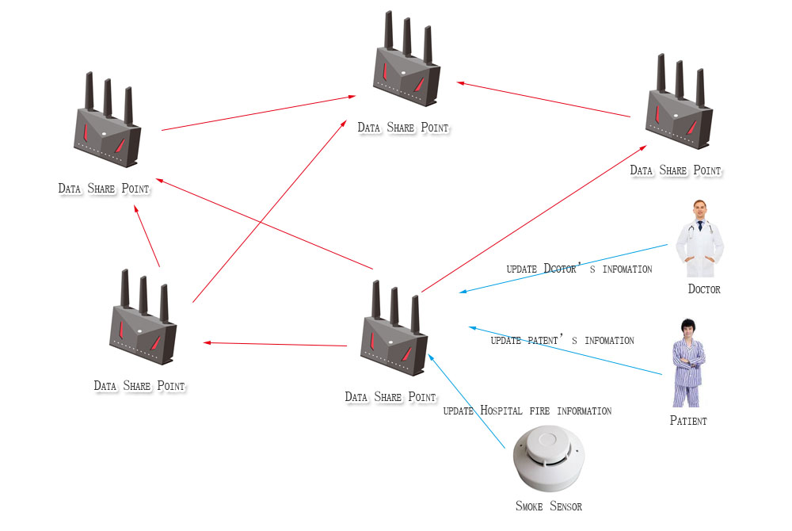
What is Share-To-Share mode

Slide 4
system composition
1、Sharer
（1）Data converter
（2）Data aggregator
2、Communication specification
（1）Standard communication protocols is needed
（2）Transmission mode includes active and passive
（3）Addressing function

Slide 5
Share-To-Share advantage
If legal, any sharer can access each other
It can access unlimited access points
Distributed computing around the world and fast and accurate response
The investment is small because the system is implemented by installing protocol conversion interface on the existing system

Slide 6
Case 1 Material distribution integrated platform
1、background
The global material procurement is in a state of chaos (no manufacturer can be found, material storage, transportation and other potential safety hazards exist, such as the German seizure of Swiss materials), and the material distribution needs to be managed comprehensively.
2、target
（1）Establish an independent, safe and unrestricted material procurement platform.
（2）It can track all links of material production and transportation to ensure the safety and reliability of materials.

Slide 7
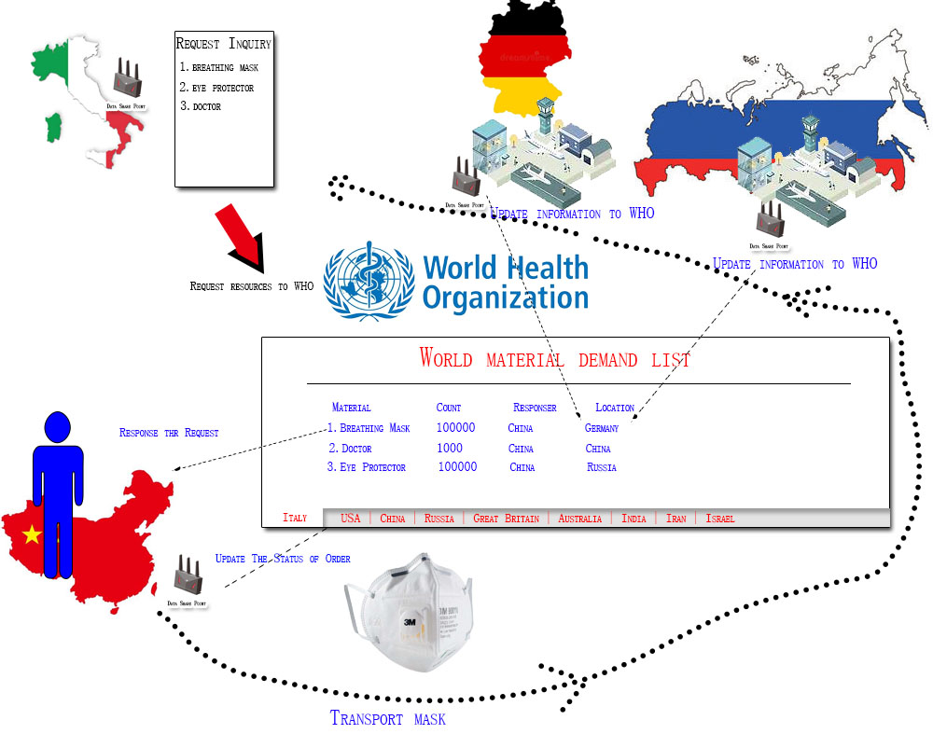

Slide 8
Thank you ！

